Slide 1
Polymorphism
Downcasting

Slide 2
Polymorphism
Single method call behaves differently depending on the type of the object which the call references
We can store a reference to a derived class object in a variable of the derived class type AND we can also store it in a variable of any direct or indirect base class
To be able to support polymorphic behavior, there are a few requirements
  The method call for the derived class object must be through a variable of a base class object
  The method called must also be a member of the base class
  The method being used must satisfy all requirements for overridden methods

Slide 3
Polymorphism
Shape
Rectangle r = new Rectangle();
Ellipse e = new Ellipse();
Shape s = r;
s.draw();
s=e;
s.draw();
int x
Draw()
Rectangle
Ellipse
int x
Draw()
int x
Draw()

Slide 4
Abstract Classes
A class must be declared abstract if any of the following condition is true
  The class has one or more abstract methods
  The class inherits one or more abstract methods for which it does not provide implementation
  The class declares that it implements an interface but does not provide implementation for every method of that interface
An abstract class cannot be instantiated
  Abstract classes defer the implementation to subclasses
  The subclass must provide the implementation of the abstract method or declare itself to be abstract in which case the implementation is deferred once again
You can declare a variable of an abstract class

Slide 5
Example: Abstract Classes
public abstract class LivingThing {
public void breath(){
System.out.println("Living Thing breathing..."); }
public void eat(){
System.out.println("Living Thing eating..."); }
public abstract void walk();
}
public class Human extends LivingThing {
public void walk(){
System.out.println("Human walks..."); }
}

Slide 6
superclass of abstract class may be concrete
A subclass can be abstract even if its superclass is concrete. For example, the Object class is concrete, but its subclasses, such as GeometricObject, may be abstract.

Slide 7
Allowed Assignments between SuperClass and Subclass Variables
Superclass and subclass assignment rules
  Assigning a superclass reference to a superclass variable is straightforward
  Assigning a subclass reference to a subclass variable is straightforward
  Assigning a subclass reference to a superclass variable is safe because of the is-a relationship
    Referring to subclass-only members through superclass variables is a compilation error
  Assigning a superclass reference to a subclass variable is a compilation error
    Downcasting can get around this error

Slide 8
Downcasting
Downcasting
  Convert a reference to a superclass to a reference to a subclass
  Allowed only if the object has an is-a relationship with the subclass

Slide 9
Task
A line is composed of two points that have coordinates x and y. The task at hand is to calculate the length of the line, given a line is composed of two points.
We also need to have methods to check if two lines are Equal, LessThan or GreaterThan each other.
(x1, y1)
(x2, y2)

Slide 10
Example
public class Line {
private double x1;
private double x2;
private double y1;
private double y2;
public Line(double x1, double x2, double y1, double y2){
this.x1 = x1;
this.x2 = x2;
this.y1 = y1;
this.y2 = y2; }

Slide 11
Example
public double getLength(){
double length = Math.sqrt((x2-x1)*(x2-x1) +
(y2-y1)* (y2-y1));
return length; }
public boolean isGreater( Line a, Line b){
double aLen = a.getLength();
double bLen = b.getLength();
return (aLen > bLen); }
public boolean isLess( Line a, Line b){
double aLen = a.getLength();
double bLen = b.getLength();
return (aLen < bLen);}
public boolean isEqual( Line a, Line b){
double aLen = a.getLength();
double bLen = b.getLength();
return (aLen == bLen); } }

Slide 12
Example
public double getLength(){
double length = Math.sqrt((x2-x1)*(x2-x1) +
(y2-y1)* (y2-y1));
return length; }
public boolean isGreater( Object a, Object b);
public boolean isLess( Object a, Object b);
public boolean isEqual( Object a, Object b);

Slide 13
public double getLength(){
double length = Math.sqrt((x2-x1)*(x2-x1) +
(y2-y1)* (y2-y1));
return length; }
public boolean isGreater( Object a, Object b){
double aLen = ((Line)a).getLength();
double bLen = ((Line)b).getLength();
return (aLen > bLen); }
public boolean isLess( Object a, Object b){
double aLen = ((Line)a).getLength();
double bLen = ((Line)b).getLength();
return (aLen < bLen);}
public boolean isEqual( Object a, Object b){
double aLen = ((Line)a).getLength();
double bLen = ((Line)b).getLength();
return (aLen == bLen); } }

Slide 14
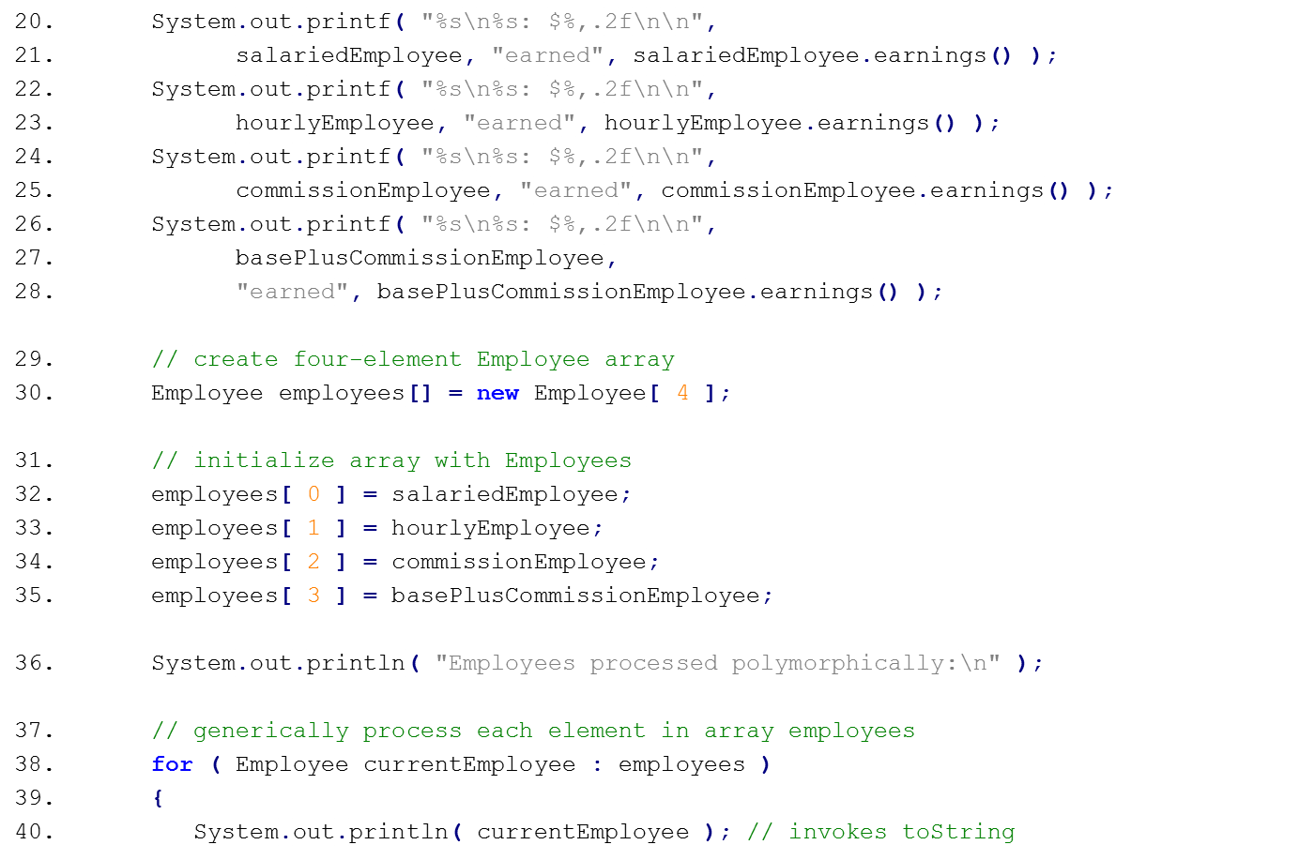
PAYROLLSYSTEMTEST EXAMPLE
Assigning subclass objects to supercalss variables
Implicitly and polymorphically call toString

Slide 15
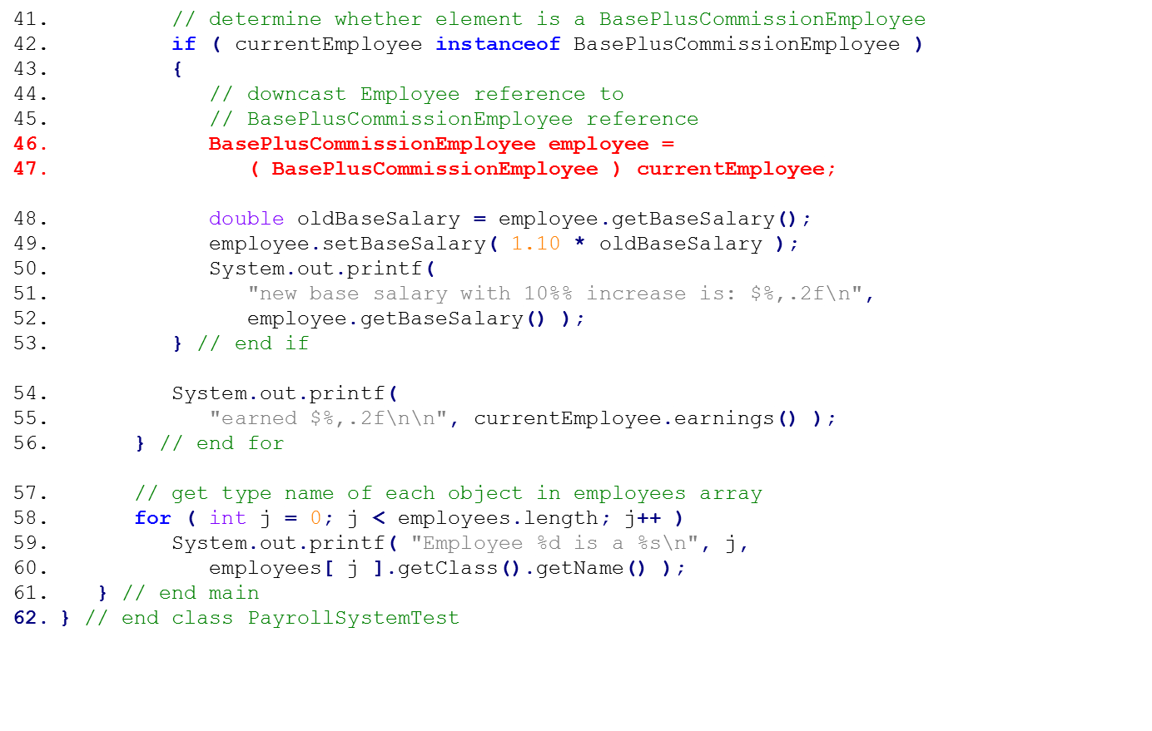
If the currentEmployee variable points to a BasePlusCommissionEmployee object
Downcast currentEmployee to a BasePlusCommissionEmployee reference
Give BasePlusCommissionEmployees a 10% base salary bonus
Polymorphically call earnings method
Call getClass and getName methods to display each Employee subclass object's class name

